Slide 1
www.osha.gov
We Can Help
OSHA Update
Julie A. Weis, Compliance Assistance Specialist
Cleveland OSHA Office
October 20, 2017

Slide 2
Secretary of Labor
Alex Acosta
Still waiting for Assistant Secretary of Labor for OSHA to be announced…….

Slide 3
www.osha.gov
We Can Help
www.osha.gov
OSHA’s Continuing Mission
More than 4,000 Americans die from workplace injuries every year.
Perhaps as many as 50,000 workers die from illnesses in which workplace exposures were a contributing factor.
More than 3 million workers suffer a serious non fatal injury or illness annually.

Slide 4
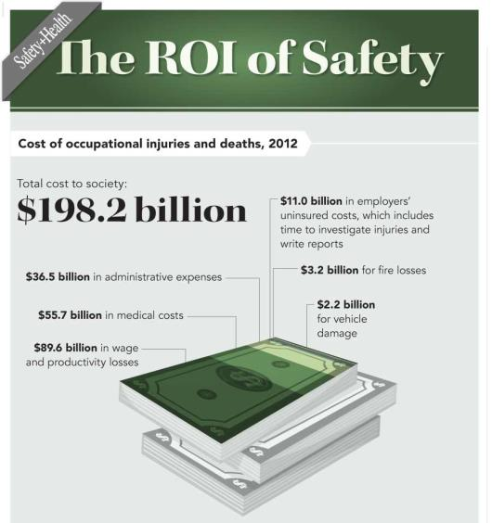
www.osha.gov
We Can Help
www.osha.gov
Workplace injuries and fatalities cost our economy $198.2 billion a year.
— National Safety Council
“Injury Facts” 2014

Slide 5
www.osha.gov
We Can Help
www.osha.gov
Safety Pays
Investing in preventing hazards saves lives, prevents injuries and saves you money
OSHA’s Updated Safety Pays Program helps show the impact of injuries and illnesses

Slide 6
Updates to OSHA’s Recordkeeping/Reporting Rule: Severe Injury Reporting
www.osha.gov
We Can Help
OSHA has expanded the list of severe injuries & illnesses that employers must report & updated the list of industries who are partially exempt from routinely keeping OSHA records.
For workplaces under Federal OSHA jurisdiction
Final rule became effective January 1, 2015

Slide 7
www.osha.gov
We Can Help
www.osha.gov
Expanded reporting requirements
The rule expands the list of severe work-related injuries and illnesses that all covered employers must report to OSHA.
Since January 1, 2015, employers must report the following to OSHA:
All work-related fatalities within 8 hours (same as previous requirement)
All work-related in-patient hospitalizations of one or more employees within 24 hours
All work-related amputations within 24 hours
All work-related losses of an eye within 24 hours

Slide 8
www.osha.gov
We Can Help
How can employers report to OSHA?
By telephone to the nearest OSHA office during normal business hours.
By telephone to the 24-hour OSHA hotline (1-800-321-OSHA or 1-800-321-6742).
Online: www.osha.gov/report.html

Slide 9
Inspections/RRIs by Area Office

Slide 10
Improving Tracking Final Rule: Timeline Dec. 1, 2017
www.osha.gov
We Can Help
As of August 1st, the online electronic submission applications is working. Updates will be posted to the OSHA website at www.osha.gov/recordkeeping when they are available.
Final Rule Federal Register Notice – May 12, 2016
Employee Rights effective date – August 10, 2016 (enforcement delayed to Dec. 1, 2016)
Electronic Reporting effective date – January 1, 2017
Phase-in data submission due dates
Submission year | Establishments with 250 or more employees in industries covered by the recordkeeping rule | Establishments with 20-249 employees In select industries | Submission deadline
2017 | CY 2016 300A Form | CY 2016 300A Form | July 1, 2017
2018 | CY 2017 300A, 300, 301 Forms | CY 2017 300A Form | July 1, 2018
2019 and beyond | 300A, 300, 301 Forms | 300A Form | March 2

Slide 12
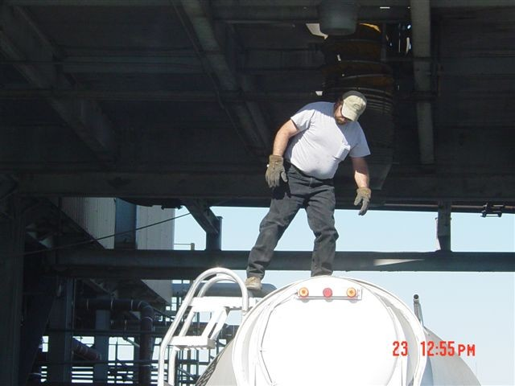
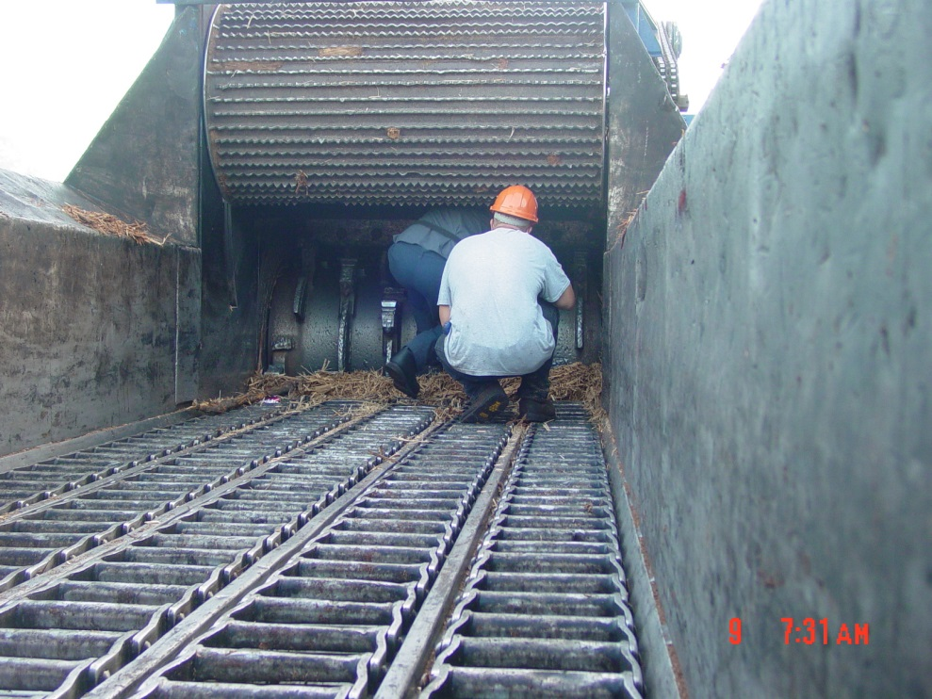
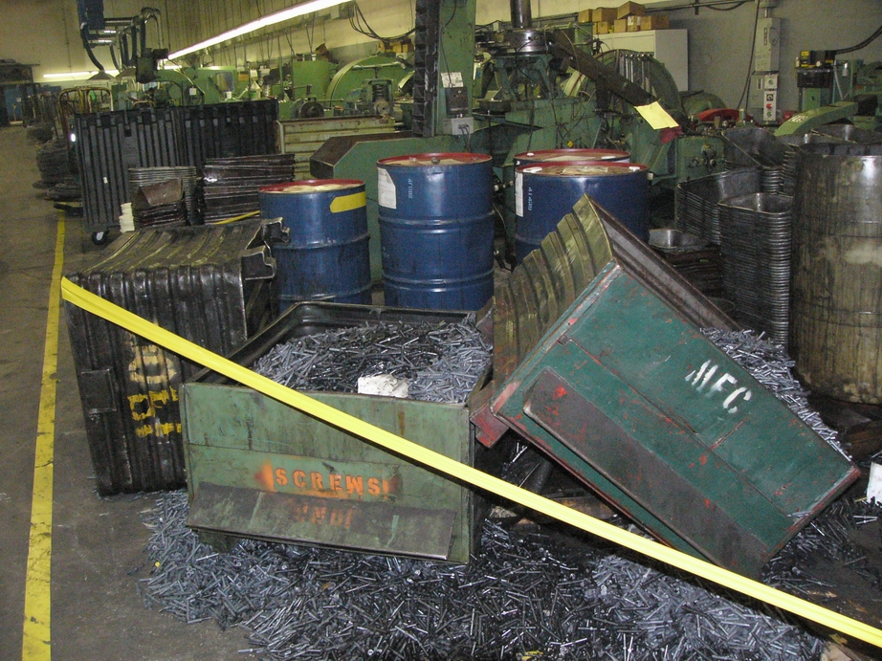
The “Big 3” Falls, Caught-In, Struck-By
The “Big 3” comprises 80% of all fatalities in Region V.

Slide 13
www.osha.gov
We Can Help
www.osha.gov
New OSHA Standards
Silica
Walking-Working Surfaces
Beryllium

Slide 14
www.osha.gov
We Can Help
www.osha.gov
Silica: Most Important Reason for the Rule
Previous PELs do not adequately protect workers
Exposure to respirable crystalline silica has been linked to:
Silicosis
Lung cancer
Chronic obstructive pulmonary disease
Kidney disease
Extensive epidemiologic evidence that lung cancer and silicosis occur at exposure levels below
100 µg/m³
Notes:
Most importantly, evidence indicates that the previous PELs do not adequately protect workers.
Respirable crystalline silica has long been recognized to cause silicosis, a progressive, irreversible, and potentially fatal lung disease.
In the years since OSHA adopted the previous PELs, evidence has developed showing that silica exposure causes lung cancer.
Both the National Toxicology Program and the International Agency for Research on Cancer have identified respirable crystalline silica as a human carcinogen.
Silica has also been linked to other lung diseases such as chronic obstructive pulmonary disease, as well as kidney and immune system diseases.

Slide 15
www.osha.gov
We Can Help
www.osha.gov
Silica Standard: General Industry/Maritime Compliance Dates
Employers must comply with all requirements of the standard by June 23, 2018, except:
Employers must comply with the action level trigger for medical surveillance by June 23, 2020. (The PEL is the trigger from June 23, 2018 through June 23, 2020.)
Hydraulic fracturing operations in the oil and gas industry must implement engineering controls to limit exposures to the new PEL by June 23, 2021.
Notes:
Employers are required to comply with most provisions of the standard by June 23, 2018.
Requirements for medical surveillance are phased in – workers exposed above the PEL for 30 or more days per year must be offered medical exams beginning on June 23, 2018; workers exposed at or above the action level for 30 or more days per year must be offered medical exams beginning on June 23, 2020.
Hydraulic fracturing employers are given additional time to implement engineering controls to achieve the new PEL in order to take advantage of further development of emerging technologies in the industry.

Slide 16
www.osha.gov
We Can Help
www.osha.gov
Silica Standard: Construction Compliance Dates
Employers must comply with all requirements (except methods of sample analysis) by
Sept. 23, 2017 extended to (Oct. 23, 2017)
Compliance with methods of sample analysis required by June 23, 2018
Notes:
Employers have until June 23, 2017 to comply with most provision of the construction standard.
Controls for most construction tools are readily available and can be quickly adopted.
Most construction employers are expected to use Table 1 and will not need to measure worker exposures to respirable crystalline silica.
Employers who measure employee exposures have until June 23, 2018, to use laboratories that follow the procedures for sample analysis in Appendix A of the standard.

Slide 17
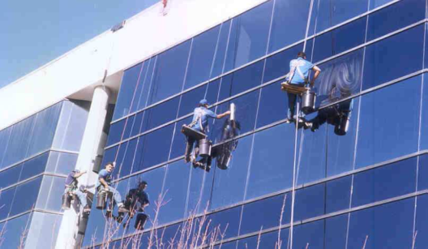
www.osha.gov
We Can Help
www.osha.gov
Walking-Working Surfaces and PPE (Fall Protection) Rule: Purpose
To update the outdated subpart D standard, incorporating new technology and industry practices
To increase consistency with OSHA’s construction standards (CFR 1926 subparts L, M, and X)
To add new provisions to subpart I that set forth criteria requirements for personal fall protection equipment

Slide 18
www.osha.gov
We Can Help
www.osha.gov
Walking-Working Surfaces and PPE (Fall Protection) Rule
OSHA estimates 6.9 million general industry establishments employing 112.3 million workers will be affected
OSHA estimates the new rule will prevent 29 fatalities and 5,842 injuries annually

Slide 19
www.osha.gov
We Can Help
www.osha.gov
Walking-Working Surfaces and PPE (Fall Protection) Rule: Major Changes
Fall Protection Flexibility
Updated Scaffold Requirements
Phase-in of ladder safety systems or personal fall arrest systems on fixed ladders
Phase-out of “qualified climbers” on outdoor advertising structures
Rope descent systems (RDS)
Adds requirements for personal fall protection equipment (final §1910.140)
Rule overall: January 17, 2017

Slide 20
www.osha.gov
We Can Help
www.osha.gov
Beryllium Standard
Final rule to prevent chronic beryllium disease and lung cancer; Standards for general industry, construction, shipyards
Reduces the permissible exposure limit (PEL) for beryllium to 0.2 micrograms per cubic meter of air, averaged over 8-hours.
OSHA estimates the rule will save 94 lives and prevent 46 new cases of chronic beryllium disease each year
Effective date is May 20, 2017;
(Challenges in court)

Slide 21
www.osha.gov
We Can Help
www.osha.gov
Higher OSHA Penalties
As of Aug. 1, 2016, the penalties OSHA can impose increased. This was a one-time catch-up adjustment.
There will also be annual adjustments based on inflation. New penalty amounts as of Jan. 13, 2017:
Type of Violation | Penalty
Serious | $12,675 per violation
Failure to Abate | $12,675 per day beyond the abatement date
Willful or Repeated | $126,749 per violation
See www.osha.gov/penalties

Slide 22
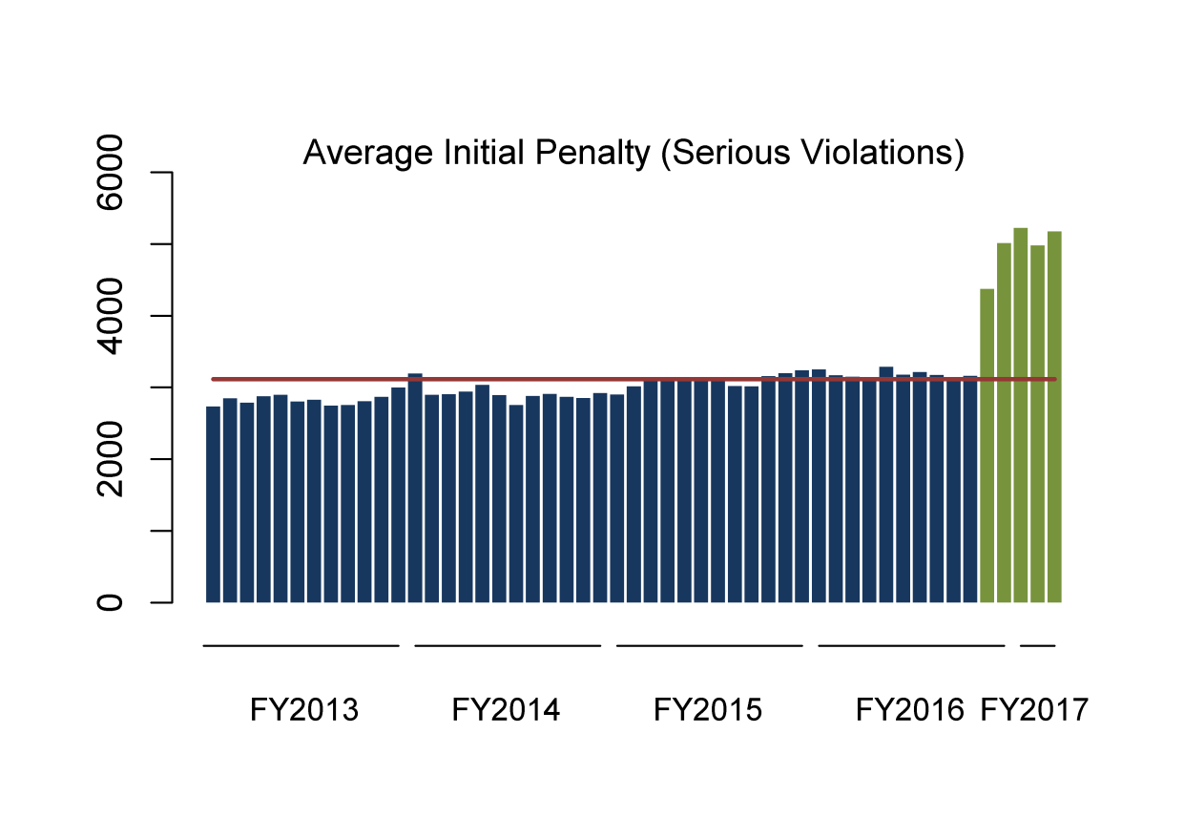
National Monthly Violation Metrics Federal OSHA
Average, FY2013 – Dec. 2016

Slide 23
www.osha.gov
We Can Help
Top Ten
Violations
Most frequently cited OSHA standards during FY 2017 inspections
1. Fall Protection—General Requirements
2. Hazard Communication
3. Scaffolding
4. Respiratory Protection
5. Lockout/Tagout
6. Ladders
7. Powered Industrial Trucks
8. Machine Guarding
9. Fall Protection – Training
10. Electrical – Wiring Methods
Notes:
This is a list of the top 10 most frequently cited standards following inspections of worksites by federal OSHA. OSHA publishes this list to alert employers about these commonly cited standards so they can take steps to find and fix recognized hazards addressed in these and other standards before OSHA shows up.

Slide 24
Employer’s Responsibility to…
Train Your Employees
Workers have a right to get training from employers on a variety of health and safety hazards and standards that employers must follow.
Required training covers topics such as, lockout-tagout, first- aid, bloodborne pathogens, haz. com., noise, confined spaces, personal protective equipment, forklift operation, emergency action plan, fire extinguishers, cranes, respiratory program (if respirators provided), among others.
****The Compliance Officer may ask for documentation on these topics****

Slide 25
Employer’s Responsibilities:
Provide a workplace free from recognized hazards and comply with OSHA standards
Provide training required by OSHA standards
Provide medical exams when required by OSHA standards and provide workers access to their exposure and medical records
Not discriminate against workers who exercise their rights under the Act (Section 11(c))
Post OSHA citations and abatement verification notices
Provide, train, and pay for PPE

Slide 26
www.osha.gov
We Can Help
www.osha.gov
OSHA’s Initiatives
Heat Illness Prevention

Slide 27
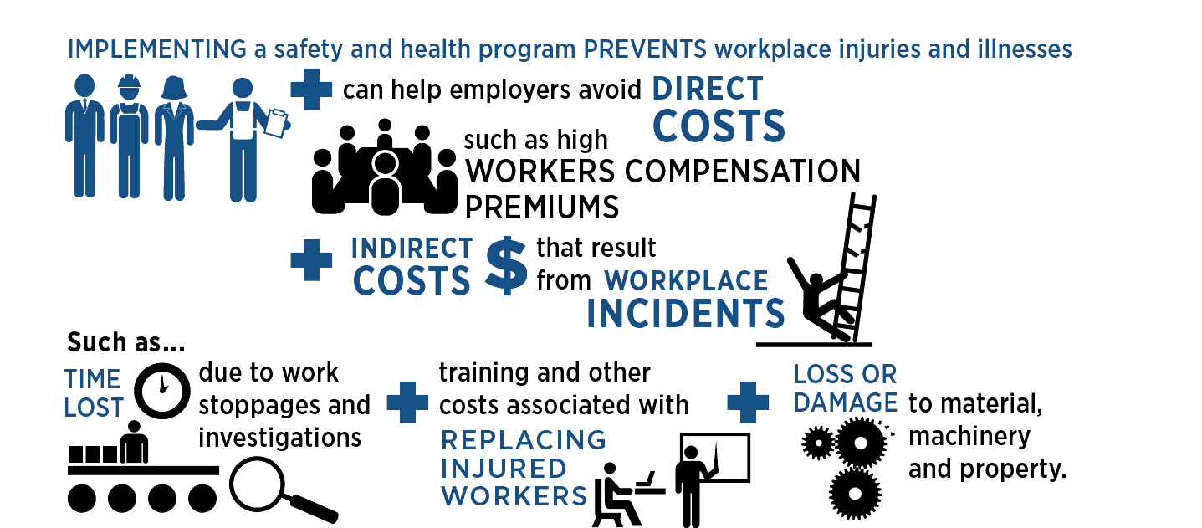
www.osha.gov
We Can Help
www.osha.gov
Safety and Health Programs
Notes:
In addition to the impact on the worker, there is a huge direct and indirect toll on the business when someone is seriously injured, made ill, or killed at work. The employer may face fines and incur costs to fix problems. There may be increased workers’ compensation premiums in their future. Business owners will be wrapped up in reporting, paperwork, and investigations, which takes time away from running the business. Work may stop, product or materials may have to be scrapped, and equipment may be damaged or taken off line. Replacement workers may have to be found and trained. Morale may decline, affecting productivity. The company’s reputation may suffer – in the community, or among customers or suppliers.

Slide 28
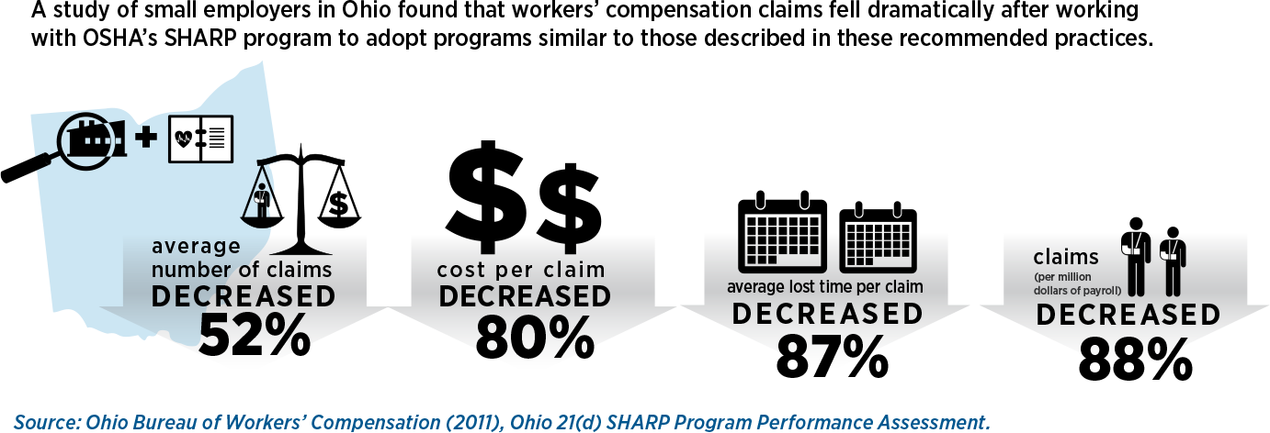
www.osha.gov
We Can Help
www.osha.gov
Safety and Health Programs Work
Notes:
Safety and health programs have been utilized for several decades. There is a growing body of evidence to support their effectiveness at reducing worker injuries, illnesses, and fatalities. They can also transform workplace culture, which can lead to higher productivity and quality and greater worker satisfaction.

Slide 29
www.osha.gov
We Can Help
www.osha.gov
OSHA’s Recommended Practices for Safety and Health Programs
Management leadership
Worker participation
Hazard identification and assessment
Hazard prevention and control
Education and training
Program evaluation and improvement
Communication and coordination for host employers, contractors and staffing agencies
Notes:
There are seven core elements that make up our Recommended Practices:
Management Leadership – This is about making safety a priority and setting a good example.
Worker Participation – This means finding ways to involve workers in all aspects of the program and giving them a sense of ownership in the program.
Hazard Identification – This element focuses on using information that is readily available, including input from workers, to identify and assess the hazards present in the workplace.
Hazard Prevention and Control – The hazards that are identified can then be prioritized based on the risk they present. Controls are planned and applied using the hierarchy of control (emphasizing elimination and substitution over administrative controls and personal protective equipment).
Education and Training – We want to ensure everyone understands how the program works, and then provide any specialized training individuals may need to fulfill their program roles.
Program Evaluation and Improvement – monitoring progress, identifying and correcting any deficiencies
Communication and Coordination for Host Employers, Contractors, and Staffing Agencies - addressing the unique challenges of managing safety when there are temporary and contract workers on site
These core elements are slightly different from our 1989 guidelines in that:
Management Leadership and Worker Participation are separate core elements
There is greater emphasis on continuous improvement with an explicit Program Evaluation and Improvement core element
We have a brand new core element covering host employer, contractor and staffing agency practices

Slide 30
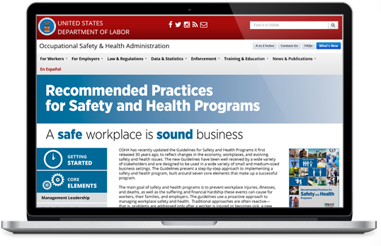
www.osha.gov
We Can Help
www.osha.gov
OSHA’s Recommended Practices for Safety and Health Programs: Website
osha.gov/shpguidelines
Notes:
You can find the Recommended Practices - along with tools and resources - on our newly-designed website: osha.gov/shpguidelines.

Slide 31
www.osha.gov
We Can Help
www.osha.gov
Safe and Sound Week: June 2017 (Inaugural Event)
Safe and Sound Week: Was held June 12-18 2017.
National Safety Stand-down to promote proactive safety and health activities, such as implementation/enhancement of safety and health programs
OSHA is working with NIOSH/ASSE/NSC/AIHA

Slide 32
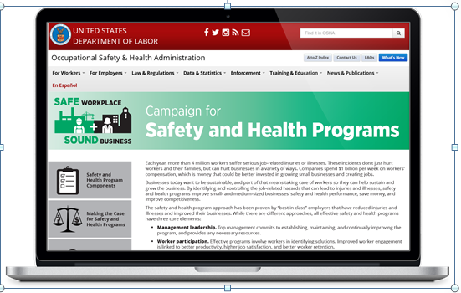
www.osha.gov
We Can Help
www.osha.gov
Campaign Website
osha.gov/shpcampaign
Notes:
To learn more about our campaign and how you can participate, go to www.osha.gov/shpcampaign

Slide 33
www.osha.gov
We Can Help
www.osha.gov
Protecting Temporary Workers
3 million people are employed by staffing companies every week.
11 million temporary and contract employees are hired by U.S. staffing firms over the course of a year.
Source: American Staffing Association

Slide 34
www.osha.gov
We Can Help
www.osha.gov
Protecting Temporary Workers: A joint responsibility
Both host employers and staffing agencies have roles in complying with workplace health and safety requirements and they share responsibility for ensuring worker safety and health.
Legally, both the host employer and the staffing agency are employers of the temporary worker.
Shared control over worker = Shared responsibility for worker

Slide 35
www.osha.gov
We Can Help
Why Are Temp Workers At High Risk of Injury?
New workers are at increased risk of injury.
Host employers don’t have the same commitment to temporary employees as to permanent ones.
Employer who bears the risk of the injury (temp agency) does not control safety and health investment.

Slide 36
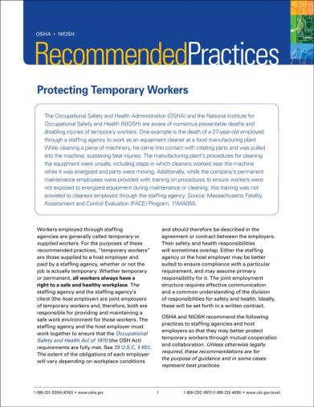
www.osha.gov
We Can Help
www.osha.gov
Temporary Workers: Outreach & Education
Alliance with American Staffing Association
Issued Temporary Worker Recommended Practices
Developed Series of Compliance Assistance Bulletins

Slide 37
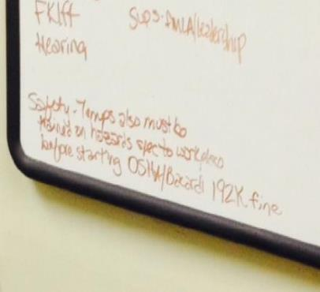
www.osha.gov
We Can Help
Temporary Worker Initiative
In all inspections, OSHA’s inspectors ask about the presence of temp workers, the hazards to which they are exposed, and the training they have received.
We are seeing an impact.

Slide 38
Heat Index | Risk Level | Protective Measures
Less than 91°F | Lower (Caution) | Basic heat safety and planning
91°F to 103°F | Moderate | Implement precautions and heighten awareness
103°F to 115°F | High | Additional precautions to protect workers
Greater than 115°F | Very High to Extreme | Triggers even more aggressive protective measures
For next summer……Develop a Heat Stress Policy

Slide 39
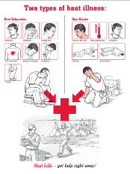
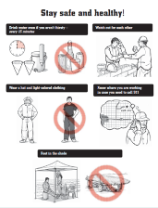
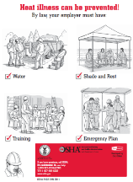
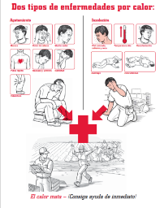
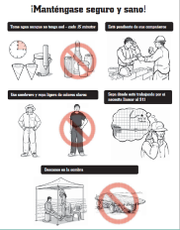
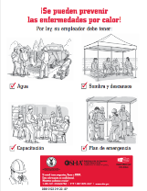
HEAT FACT SHEETS and NEED FOR POLICY
Notes:
Heat Campaign Q and As.
Q. What do workers needs to know when exposed to extreme temperatures?
Water. Rest. Shade. Three little words that make a big difference for outdoor workers. Workers need to be drinking plenty of water, taking more frequent breaks and getting out of the sun periodically throughout the day.
Q. What are the risks?
A2. Each year thousand of outdoor workers experience heat illnesses such as heat exhaustion. The body normally cools itself by sweating. During hot weather, especially with high humidity, sweating isn't enough. Body temperature can rise to dangerous levels if precautions are not taken.
Q. What are the symptoms?
It is important to recognize the symptoms of heat illness
cramps that typically begin suddenly in the hands, calves, or feet
Hard, tense muscles
Fatigue
Nausea
Headaches
Excessive thirst
Weakness
Confusion or anxiety
Drenching sweats, often accompanied by cold, clammy skin.
Slowed or weakened heartbeat.
Dizziness
Fainting
Agitation
Get the ill worker out of the heat as soon as possible. Heat illness can lead to heat stroke which killed more than 30 workers last year.
Q3. Why causes workers to get ill?
Workers become overheated from two primary sources:
the environmental conditions in which they work and
the internal heat generated by physical labor.
Heat-related illnesses occur when the body is not able to lose enough heat to balance the heat generated by physical work and external heat sources. Weather conditions are the primary external heat sources for outdoor workers.
Q. Who is vulnerable?
Outdoor workers such as those in construction, streets and sanitation, first responders, amusement park workers and landscaping are often overlooked when we warn the public about extreme temperatures.
Q. What resources are available?
OSHA has a website dedicated to heat prevention for outdoor workers which includes pictures to show workers what symptoms to look for, what to do to prevent heat illness and what to do in an emergency. See www.osha.gov. These materials are available in both English and Spanish.
Q. How are you working to get the word out?
OSHA is also partnering with the National Oceanic and Atmospheric Administration (NOAA) on weather service alerts. NOAA’s Heat Watch page now includes worker safety precautions when extreme heat alerts are issued.
Q. Monitor the heat index
Workers should also monitor the heat index. OSHA has an APP for that. OSHA released a free application for mobile devices that enables workers and supervisors to monitor the heat index at their work sites and reminders about protective measures that should be taken at that risk level. It is available for Android-based platforms and the iPhone, the app can be downloaded in both English and Spanish by visiting www.osha.gov.

Slide 40
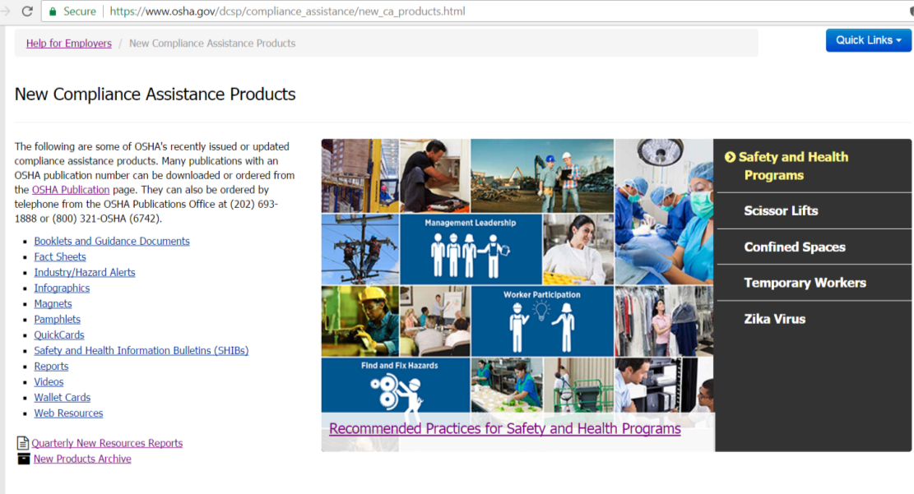
www.osha.gov
We Can Help
www.osha.gov
New OSHA Resources
For a listing of new OSHA publications, web pages, videos, and other resources, visit OSHA’s Help for Employers page (www.osha.gov/employers), and click on “New Products” in the Quick Links box.

Slide 41
www.osha.gov
We Can Help
www.osha.gov
OSHA QuickTakes
Free OSHA e-newsletter delivered twice monthly to 170,000 subscribers
Latest news about OSHA initiatives and products to help employers and workers find and prevent workplace hazards
Sign up at www.osha.gov
Notes:
To keep up with the latest OSHA developments, subscribe to the twice monthly OSHA e-newsletter called QuickTakes.

Slide 42
What’s an employer to do?
Prepare in advance; do you have a SHMS?
Be honest with the compliance officer
Good faith plays a role in how your case is evaluated
If you receive citations and penalties, come in to the informal conference and discuss your case with the Area Director to obtain a workable settlement agreement…and bring with you abatement documentation!

Slide 43
On-Site Consultation (Free Service) 1-800-282-1425
Walkthrough Surveys/Air Monitoring
Help with Written Programs
Written Report
https://www.osha.gov/dcsp/smallbusiness/consult.html

Slide 44
Thank You!!!
Cleveland OSHA Office
216-447-4194
We Can Help

